Slide 1

UNIVERSITY INSTITUTE OF ENGINEERING
COMPUTER SCIENCE ENGINEERING
Computer Vision (CST-422)
Prepared By : Payal Thakur(E12720)
Topic: Machine Learning Workflow
DISCOVER . LEARN . EMPOWER

Slide 2
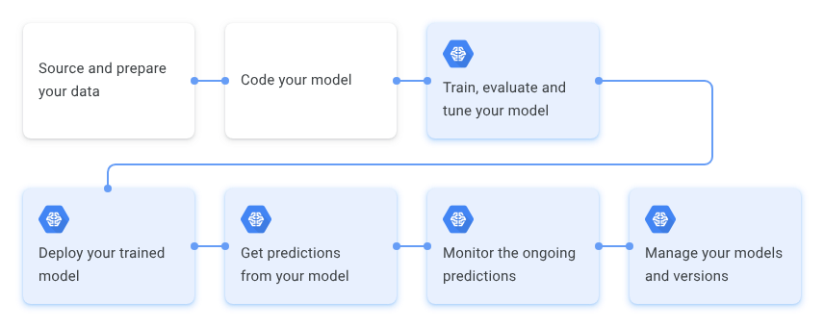
Machine Learning Workflow
The machine learning workflow for image processing involves several steps, from data collection and preprocessing to model training and evaluation.

Slide 3
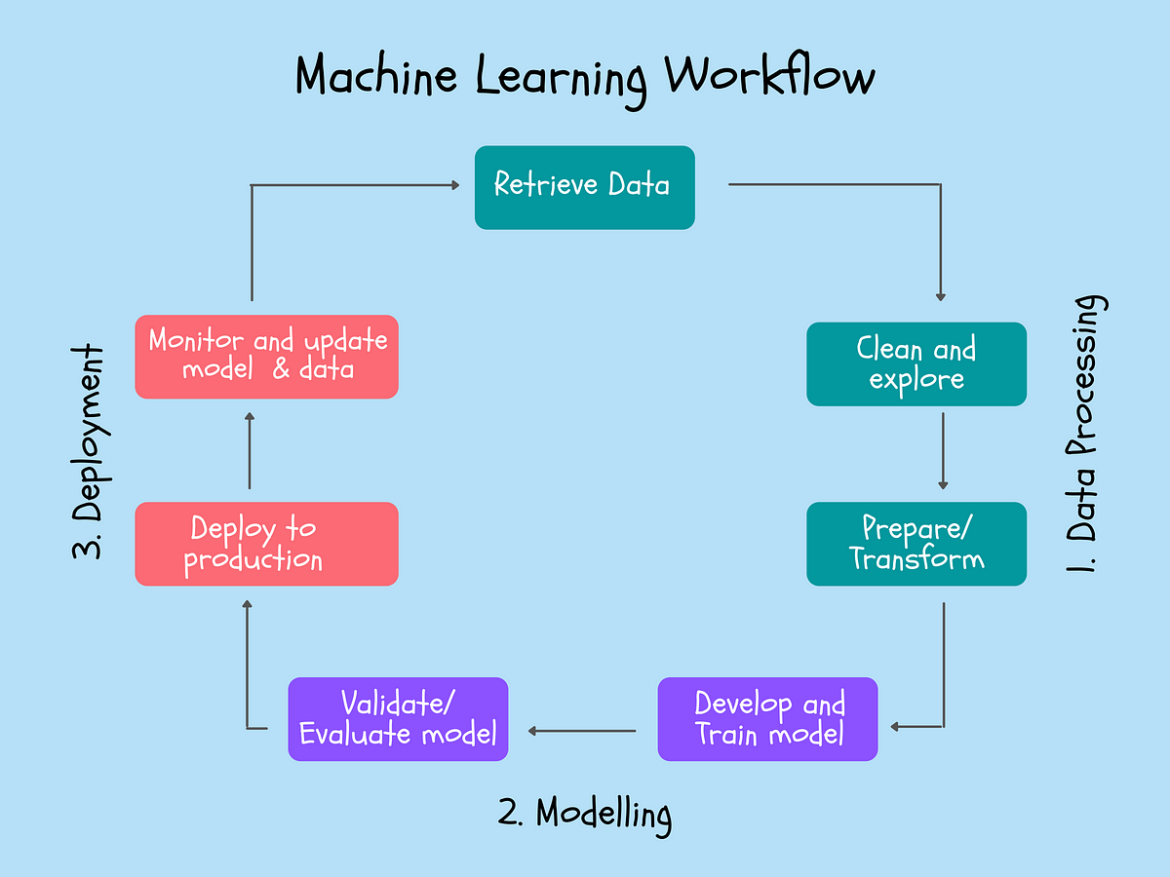
Machine Learning Workflow

Slide 4

Steps Involved in Image Classification
Data Collection:
Gathering a dataset of labeled images.
Dataset should be diverse and representative of the real-world images.

Slide 5
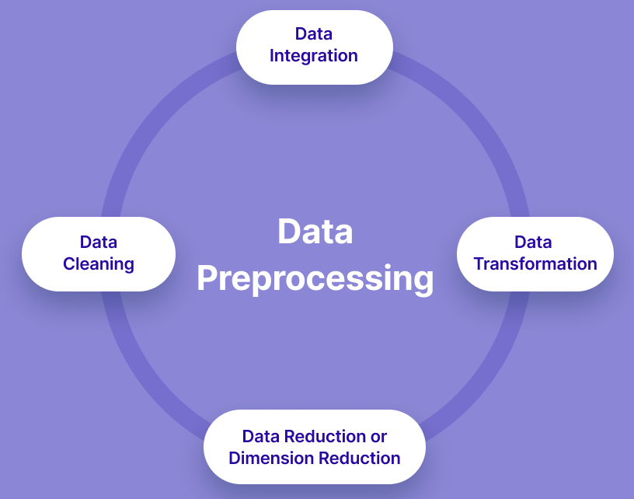
Machine Learning Workflow
2. Data Preprocessing:
Preprocessing the images to ensure they are in a suitable format for training.
Involves resizing the images to a consistent size, normalizing pixel values, removing noise, and applying data augmentation techniques such as rotation, flipping, or zooming to increase the variability of the dataset.

Slide 6
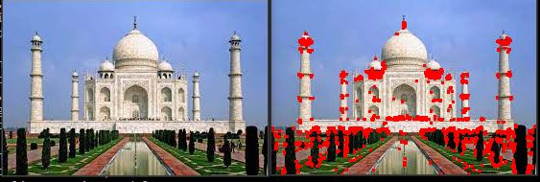
Machine Learning Workflow
3. Feature Extraction:
Extracting meaningful features from the images to represent their visual content.
Involves manually designing feature extractors, such as edge detectors, texture descriptors, or color histograms.

Slide 7
Machine Learning Workflow
4. Data Split:
Split the dataset into training, validation, and testing sets.
The training set is used to train the machine learning model
The validation set is used to tune hyperparameters and evaluate model performance during training
The testing set is used to assess the final model's generalization ability.

Slide 8
Machine Learning Workflow
5. Model Selection:
Choose an appropriate machine learning algorithm or model for your image processing task.
Can include traditional machine learning algorithms like support vector machines (SVMs), decision trees, or random forests.

Slide 9
Machine Learning Workflow
6. Model Training:
Train the selected machine learning model using the preprocessed image data.
The model learns to map the input images to their respective classes or perform specific image processing tasks.
The training process involves optimizing the model's parameters using an appropriate optimization algorithm like stochastic gradient descent (SGD) or Adam that minimizes a defined loss function.

Slide 10
Machine Learning Workflow
7. Hyperparameter Tuning:
Adjust the hyperparameters of the machine learning model to optimize its performance.
Hyperparameters include parameters that are set before the training process, such as learning rate, regularization strength, batch size, or network architecture.
Hyperparameter tuning techniques, such as grid search or random search, can be used to find the optimal combination of hyperparameters.

Slide 11
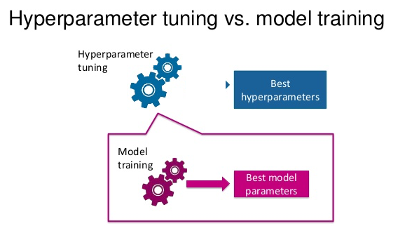
Machine Learning Workflow

Slide 12
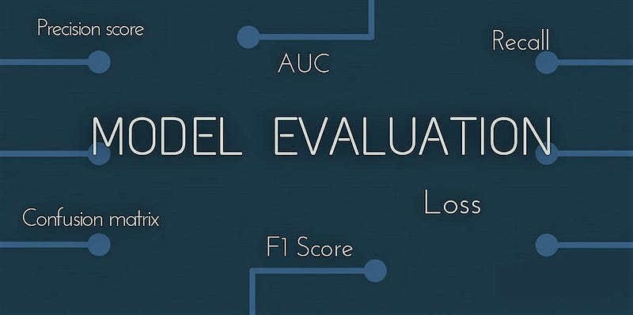
Machine Learning Workflow
8. Model Evaluation:
Assessing the trained model's performance on a separate validation dataset to measure its accuracy, precision, recall, or other relevant metrics.
Helps in assessing the model's generalization ability and identifying potential issues like overfitting or underfitting.
Adjust the model's hyperparameters or architecture if necessary to improve performance.

Slide 13
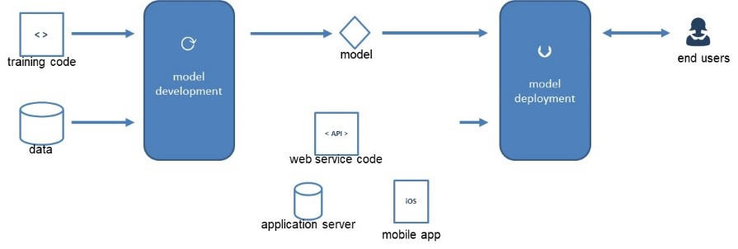
Machine Learning Workflow
6. Model Deployment:
Once the model performs satisfactorily, it can be deployed to classify new, unseen images.
Done by feeding the image through the trained model, which outputs the predicted class or a probability distribution over the classes.
Involves applying the trained model to classify images, detect objects, segment regions of interest, or perform other specific image processing tasks based on the learned patterns.

Slide 14
Machine Learning Workflow
6. Continuous Improvement:
Iterate on the workflow to improve the model's performance.
Involves collecting additional data, refining preprocessing techniques, experimenting with different algorithms or architectures, or fine-tuning the model parameters.

Slide 15
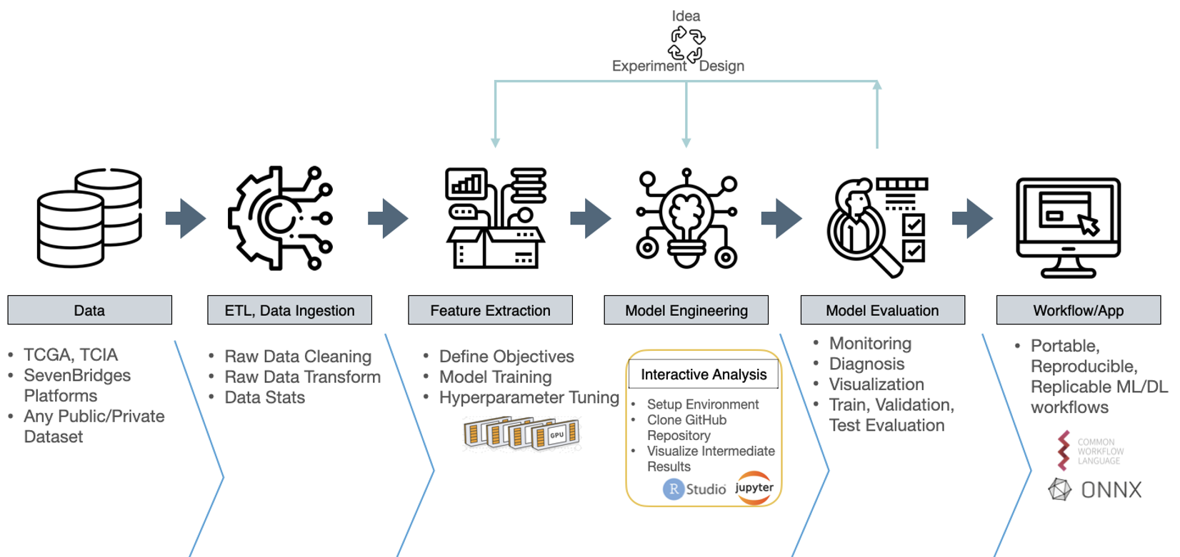
Machine Learning Workflow

Slide 16
References:-
Books:-
"Introduction to Computer Vision" by David Forsyth and Jean Ponce. Chapter 6: Features and Descriptors provides an in-depth explanation of feature detection, extraction, and matching algorithms.
Computer Vision: Algorithms and Applications" by Richard Szeliski. Chapter 4: Image Features covers various feature detection, extraction, and matching techniques.
Video Links
"Feature Detection and Description" by Stanford University - Computer Vision (CS231n). Available on YouTube: https://www.youtube.com/watch?v=H-HVZJ7kGI0
"Feature Matching and Homography" by University of Washington - Computer Vision (CSE 576). Available on YouTube: https://www.youtube.com/watch?v=uvSCXyYpG9k
"Introduction to Feature Detection and Matching" by OpenCV. Available on YouTube: https://www.youtube.com/watch?v=AWoG8vdw4pA

Slide 17
THANK YOU
For queries
Email: payal.e12720@cumail.in

